Slide 1
ESP32 Sleep modes

Slide 2

The Mailbox challenge
How do we trigger a “mail” event
What are some of the constraints we have
What about power?

Slide 3

Different Battery Sizes
List of battery sizes - Wikipedia

Slide 4

Sleep OPTIONS
Modem sleep
Light sleep
Deep sleep
Hibernate

Slide 5
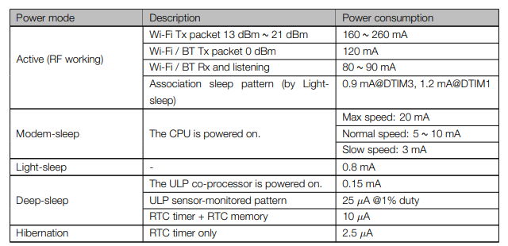
Current Consumption
From the esp32 Datasheet https://lastminuteengineers.com/datasheets/esp32-datasheet-en.pdf

Slide 6
Full power
WIFI
Peripherals
Cores
RTC
Bluetooth
Coprocessor
Light sleep
Peripherals
Bluetooth
WIFI
Peripherals
Bluetooth
WIFI
Cores
Coprocessor
RTC
Cores
Coprocessor
RTC
Deep sleep

Slide 7
Wake up modes
Light sleep | Deep sleep
Timer | Timer
Touch pad | Touch pad
External wakeup | External wakeup
(ULP Coprocessor ADC) | (ULP Coprocessor ADC)
(ULP Coprocessor i2c) | (ULP Coprocessor i2c)
GPIO wakeup
UART wakeup
https://docs.espressif.com/projects/esp-idf/en/latest/api-reference/system/sleep_modes.html#overview

Slide 8
Battery life calculator
IOT Battery Life Calculator (of-things.de)

Slide 9
Some Demos
Full Power
Light sleep with timer
Light sleep with GPIO
Deep sleep with timer
Deep sleep with GPIO

Slide 10
External Wake up sources
ESP_PD_DOMAIN_RTC_PERIPH
EXT 0
internal pullup or pulldown resistors can be used
EXT 1
internal pullup or pulldown resistors can be used but only if ESP_PD_DOMAIN_RTC_PERIPH IS ENABLED
wake up if any of the selected pins is high (ESP_EXT1_WAKEUP_ANY_HIGH)
wake up if all the selected pins are low (ESP_EXT1_WAKEUP_ALL_LOW)

Slide 11
Let’s run some test
Using EXT 1
Using EXT 2

Slide 12
Controlling deep sleep
esp_sleep_pd_config(Power_domain, Power_Domain_option = ON | off)
ESP_PD_DOMAIN_RTC_PERIPH | RTC IO, sensors and ULP co-processor.
ESP_PD_DOMAIN_RTC_SLOW_MEM | RTC slow memory.
ESP_PD_DOMAIN_RTC_FAST_MEM | RTC fast memory.
ESP_PD_DOMAIN_XTAL | XTAL oscillator.
ESP_PD_DOMAIN_RTC8M | Internal 8M oscillator.
ESP_PD_DOMAIN_VDDSDIO | VDD_SDIO
ESP_PD_DOMAIN_MAX | All Domains

Slide 13
Demos
Hibranation

Slide 14
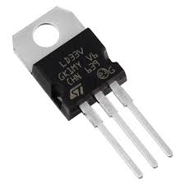
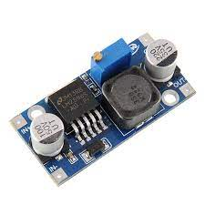
Voltage regulation
Regulator
Buck/ boost converter
VS

Slide 15
Resources
Boost calculator | https://learn.adafruit.com/diy-boost-calc/the-calculator
Buck converter | https://www.youtube.com/watch?v=W6NOV6b8kxs
Boost Converter | https://www.youtube.com/watch?v=cE2-g4QsKr0
Buck vs Regulator | https://www.youtube.com/watch?v=giGRrODKJSE

Slide 16
Bonus
Keeping time between wake ups

